Slide 1
Solutions of Topic 4 in-class Practice

Slide 2
Public Utilities
The case gives corporate data on 22 U.S. public utilities from different states.
We are interested in forming groups of similar utilities. The records to be clustered are the utilities, and the clustering will be based on the eight measurements on each utility.
The clustering results would be useful to predict the cost impact of deregulation.
To do the requisite analysis, economists would need to build a detailed cost model of the various utilities.
It would save a considerable amount of time and effort if we could cluster similar types of utilities and build detailed cost models for just one "typical" utility in each cluster and then scale up from these models to estimate results for all utilities.

Slide 3
Variables
Fixed = fixed-charge covering ratio (income/debt);
RoR = rate of return on capital;
Cost = cost per kilowatt capacity in place;
Load = annual load factor;
Demand = peak kilowatt hour demand growth last year;
Sales = sales (kilowatt hour use per year);
Nuclear = percent nuclear;
Fuel total fuel costs (cents per kilowatt hour)

Slide 4
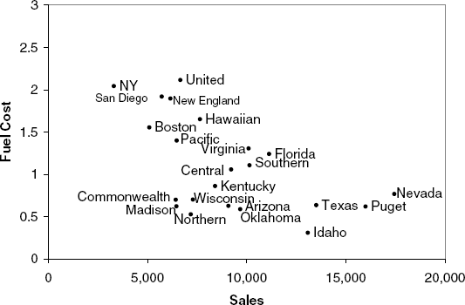
Preliminary Study
For simplicity, let’s focus in two variables (Sales and Fuel Cost) first since it is easier to visualize the relationship and get a basic understanding

Slide 5
Cluster Suggestion
At first glance, there appear to be two or three clusters of utilities:
one with utilities that have high fuel costs,
a second with utilities that have lower fuel costs and relatively low sales,
and a third with utilities with low fuel costs but high sales.
We can therefore think of cluster analysis as a more formal algorithm that measures the distance between records, and according to these distances (here, two-dimensional distances) forms clusters.

Slide 6
ANS to Question1
According to the cluster guideline of above, which group do Nevada and Commonwealth belong to?
ANS: C

Slide 7
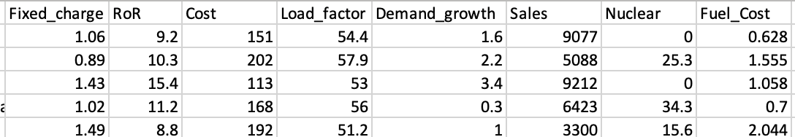
Normalization
The snapshot of the dataset shows an obvious difference in scale/magnitude among variables
So normalization is necessary before the clustering analysis

Slide 8
Question 2
The following contains the records of Sales and Fuel Cost for two companies, also the mean and sd of the two variables.
Compute the normalized values for Boston Edison Co.
Company | Sales | Fuel Cost
Arizona Pulic Service | 9,077 | 0.628
Boston Edison Co. | 5,088 | 1.555
Mean | 8,914.05 | 1.10
Standard deviation | 3,549.98 | 0.56

Slide 9
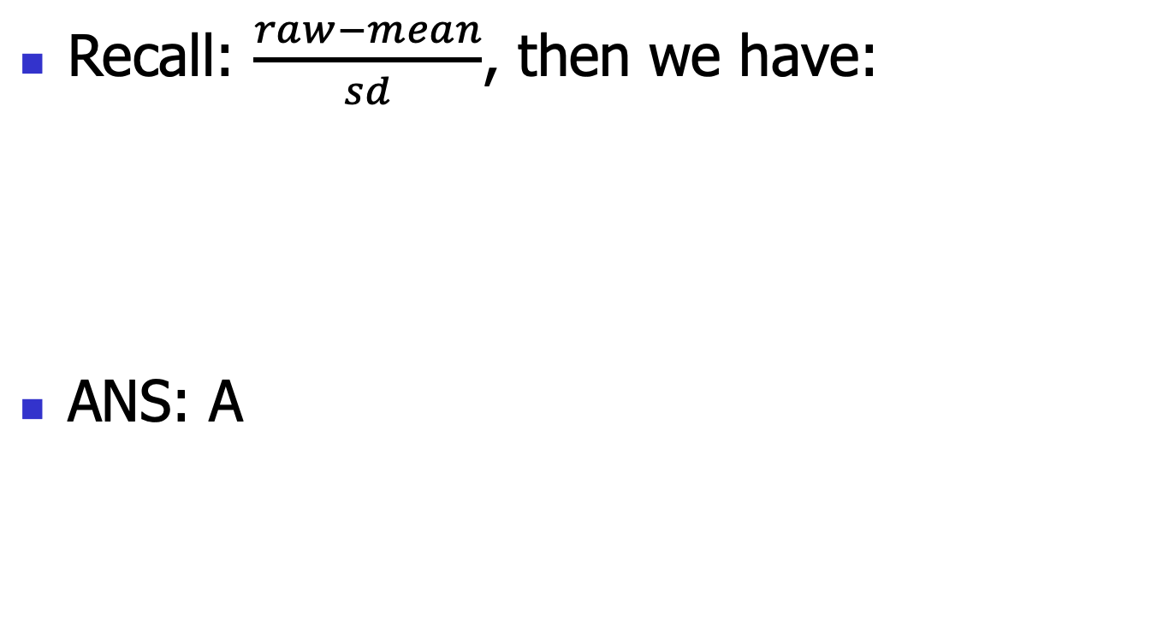
ANS to Question 2
Recall: $\frac{raw−mean}{sd}$, then we have:
ANS: A
Company | Sales | Fuel Cost
Arizona Pulic Service | 0.04590167 | -0.8428571
Boston Edison Co. | -1.0777666 | 0.8125

Slide 10
Hierarchical Clustering
Setting:
Variable: all 8 measurements
Euclidean distance is used to measure the distance between companies.
Ward linkage is used to measure the distance between clusters.

Slide 11
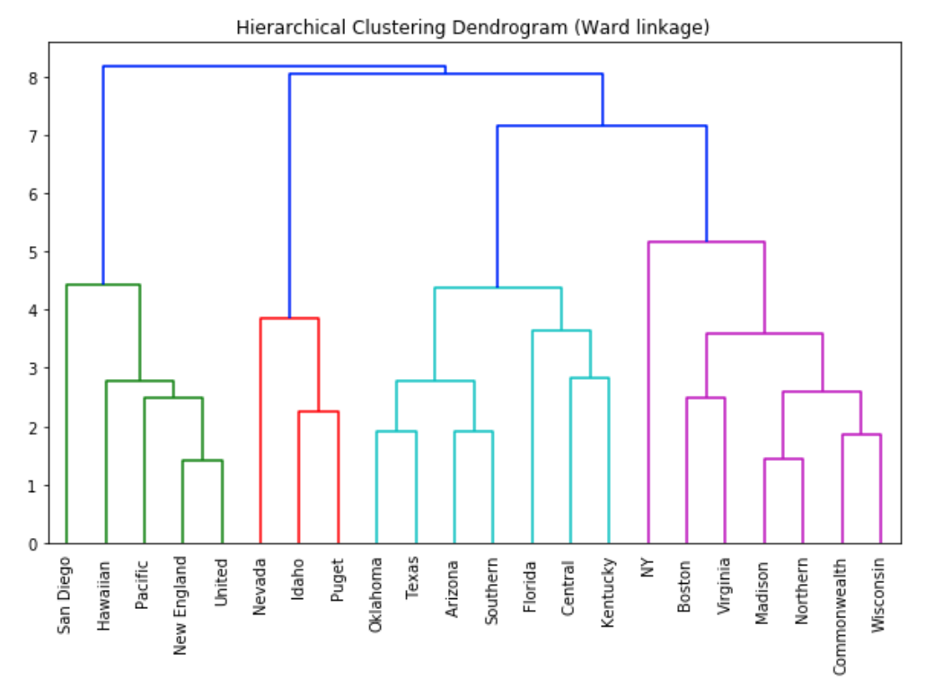
Dendrogram
Based on the dendrogram, forming 4 clusters seems to be an appropriate choice

Slide 12
ANS to Question 3
Based on the formation of 4 clusters, what is the clustering result?
ANS: A

Slide 13
Question 4
By referencing to the US map, the locations/states of the companies may help to name each cluster.
Which of the following is an appropriate cluster name for those with Texas?

Slide 14
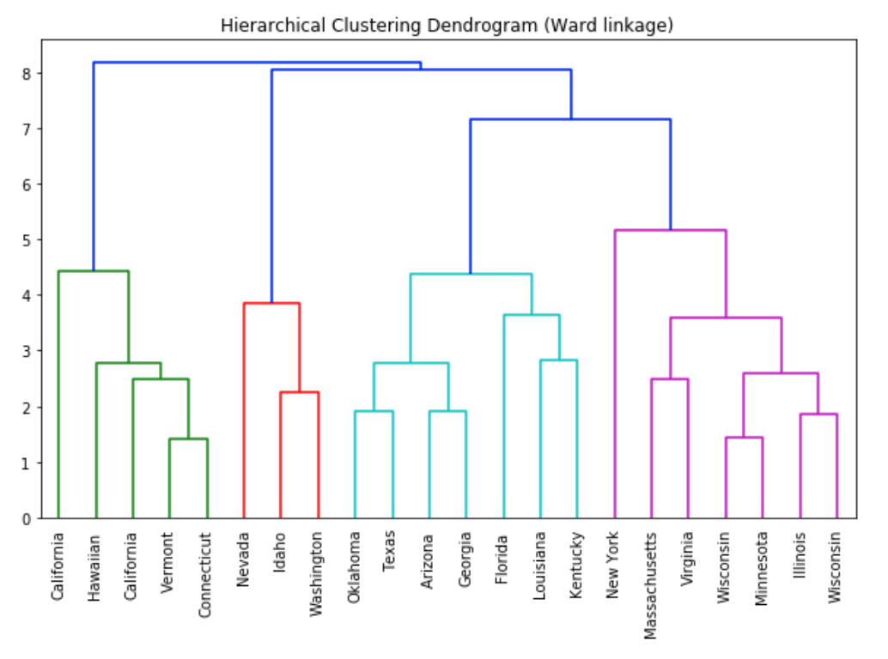
With ‘State’ as the labeling
Display by State

Slide 15
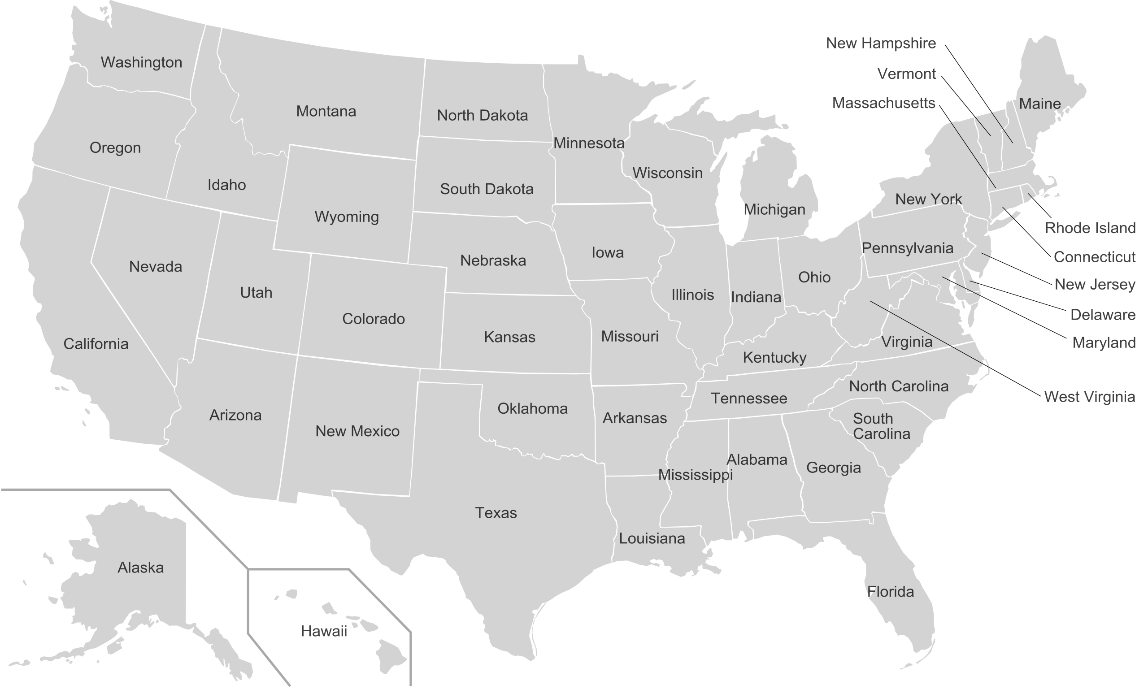
US Map

Slide 16
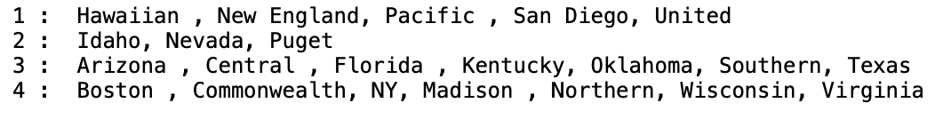
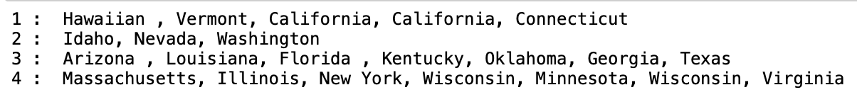
ANS to Question 4
Display by Company
Display by State

Slide 17
#2
#1
#4
#4
#4
#2
#4
#2
#4
#1
#1
#3
#4
#3
#3
#3
#3
#3
#1
#3

Slide 18
ANS to Question 4
A southern group (Cluster#3): Arizona, Oklahoma, Southern, Texas, Central Kentucky, Florida
A northern group (Cluster#4): Boston, Commonwealth, Madison, Northern States, Wisconsin, NY, Virginia
An east/west seaboard group (Cluster#1): Hawaii, New England, United, Pacific, San Diego
ANS: A

Slide 19
Insights
One insight that can be derived from this clustering is that clusters tend to group geographically.
So the economists could take geographical boarder as a starting point to build the cost model of the various utilities.

